Slide 1
University of Alkafeel,
College of Dentistry,
Year 3, Course 1
Pathology Lab 4
Acute Inflammation
By: Assistant Lecturer, Soroor M. Hadi

Slide 2
Learning Objectives
Know what Inflammation is.
Know the Cardinal Signs of Inflammation.
Know the Types of Inflammation.
Know what Acute Inflammation is and the vascular changes and cellular events that occur in it are.
Know the four Outcomes of Acute Inflammation

Slide 3
Introduction
Inflammation is the protective response of vascularized tissues to infection and tissue damage.
It serves to bring host defense cells and molecules from the circulation to the site of injury to eliminate the offending agent.

Slide 4
Cardinal Signs of Inflammation
These signs are the clinical manifestations of the vascular and cellular changes:
Rubor (Redness): Due to vasodilation and increased blood flow.
Calor (Heat): Due to increased blood flow (hyperemia) and release of chemical mediators.
Tumor (Swelling): Due to increased vascular permeability leading to fluid and protein leakage (edema/exudate).
Dolor (Pain): Due to chemical mediators (like prostaglandins) stimulating nerve endings and pressure from edema.
Functio Laesa (Loss of Function): resulting from the combined effects of pain and swelling.

Slide 5
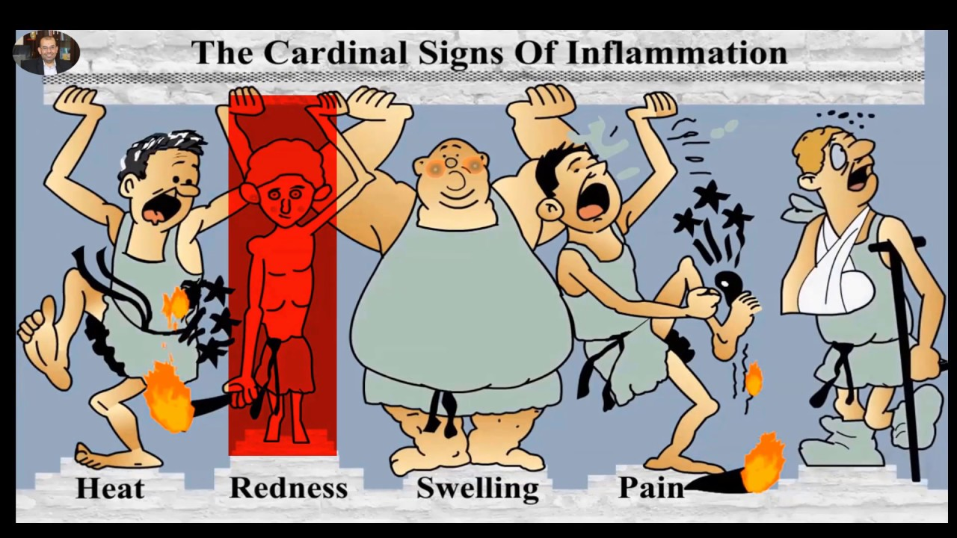
Cardinal Signs of Inflammation

Slide 6
Types of Inflammation
Inflammation is broadly classified into:
 | Acute Inflammation | Chronic Inflammation
Onset | Fast: Minutes to hours. | Slow: Days to years.
Duration | Short-lived (hours to days). | Prolonged (weeks, months, years).
Cellular Infiltrate | Primarily Neutrophils (PMNs). | Mononuclear Cells (Macrophages, Lymphocytes, Plasma Cells).
Tissue Injury | Usually mild and self-limited. | Often severe and progressive, simultaneous with attempts at repair.
Fibrosis/Repair | Minimal/Absent; may progress to scarring only in severe cases. | Prominent: Occurs concurrently with tissue destruction and inflammation (Fibrosis).
Outcomes | 1. Complete Resolution (Ideal) 2. Abscess Formation 3. Scarring (Fibrosis) 4. Progression to Chronic | Persistence, tissue destruction, and eventual fibrosis/loss of function.

Slide 7
Acute Inflammation
Acute inflammation is the initial, rapid, and short-lived response to injury, lasting from minutes to a few days. Its primary goal is to deliver white blood cells (leukocytes) and plasma proteins to the site of injury.
Acute inflammation involves two main processes:
A-Vascular Changes:
1-Transient vasoconstriction followed rapidly by pronounced vasodilation.
2-Increased vascular permeability in post-capillary venules, leading to the formation of protein-rich exudate (tissue swelling/edema).
3-Stasis (slowing of blood flow) due to increased blood viscosity.

Slide 8
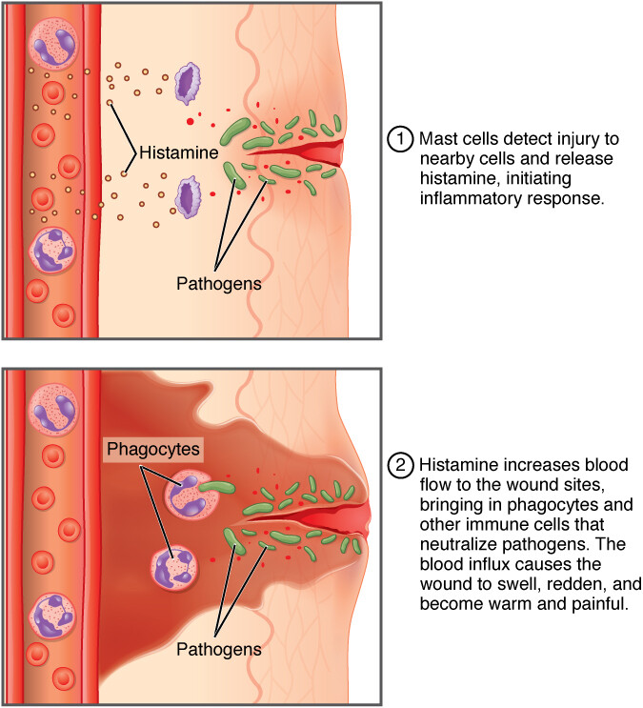
Acute Inflammation

Slide 9
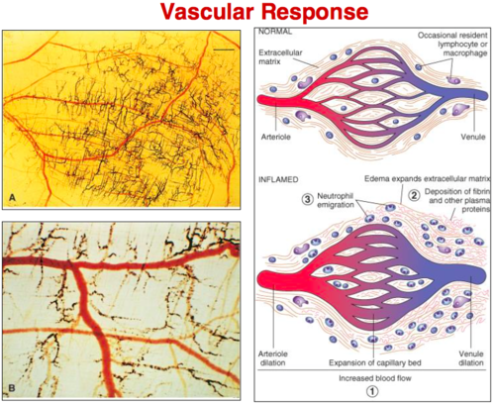
Acute Inflammation

Slide 10
Acute Inflammation
B-Cellular Events (Leukocyte Recruitment):
1-Margination and Rolling of leukocytes along the endothelium.
2-Adhesion (firm attachment) mediated by integrins and adhesion molecules.
3-Transmigration (Diapedesis) through the endothelial wall into the extravascular tissue.
4-Chemotaxis (migration along a chemical gradient) to the site of injury.
5-Phagocytosis (engulfment and destruction of the injurious agent).

Slide 11
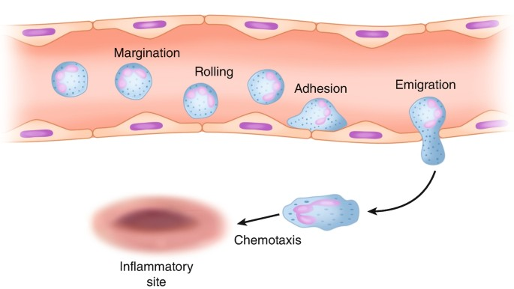
Acute Inflammation

Slide 12
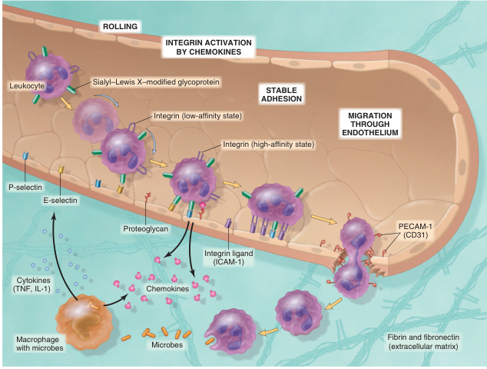
Acute Inflammation

Slide 13
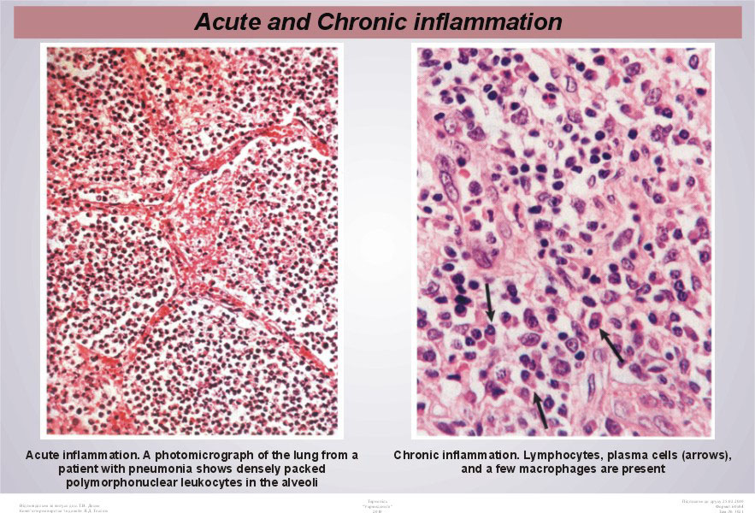
Acute Inflammation

Slide 14
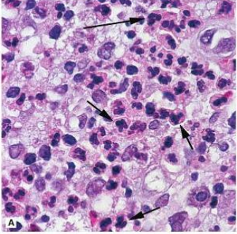
Acute Inflammation

Slide 15
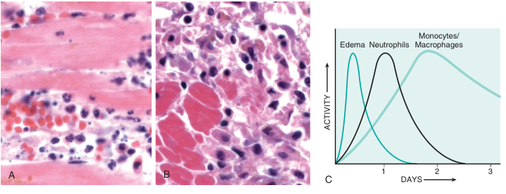
Acute Inflammation
Nature of leukocyte infiltrates in inflammatory reactions. The photomicrographs show an inflammatory reaction in the myocardium after ischemic
necrosis (infarction). (A) Early (neutrophilic) infiltrates and congested blood vessels. (B) Later (mononuclear) cellular infiltrates. (C) The approximate kinetics
of edema and cellular infiltration.

Slide 16
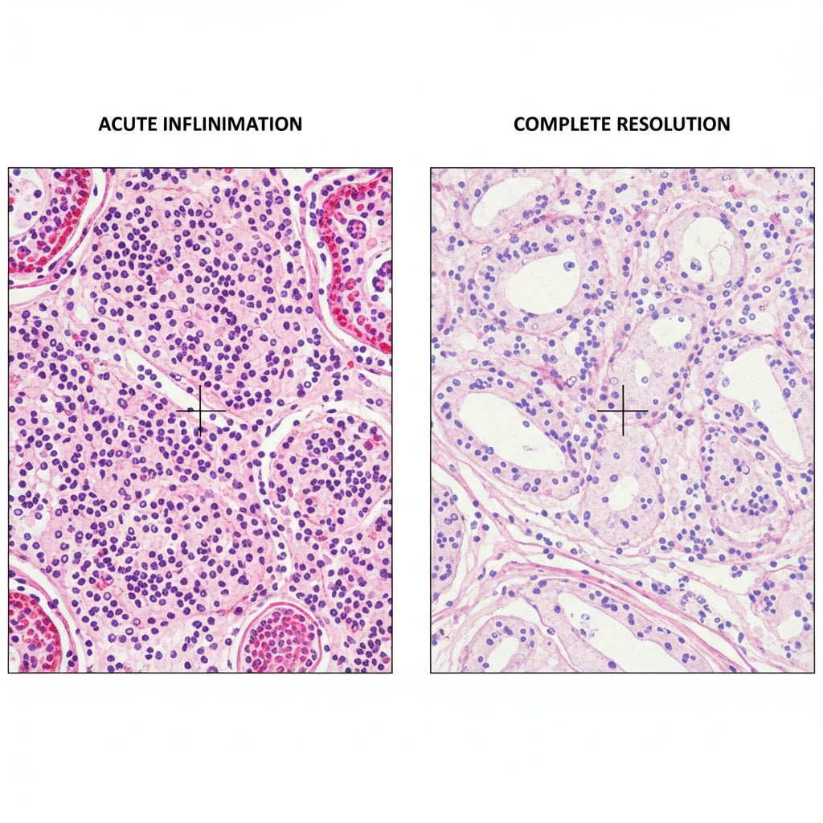
The Four Outcomes of Acute Inflammation
1-Complete Resolution: This is the ideal outcome and involves the complete restoration of the inflamed tissue to a state of normal structure and function.

Slide 17
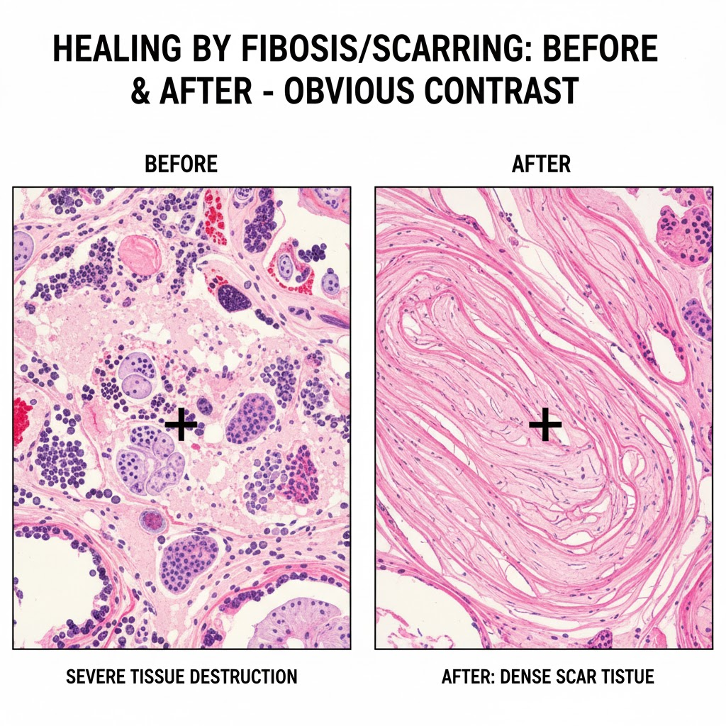
The Four Outcomes of Acute Inflammation
2-Healing by Connective Tissue Replacement (Fibrosis/Scarring) If the tissue structure is significantly destroyed and the native cells cannot regenerate, the damaged area is replaced by connective tissue, resulting in a scar.

Slide 18
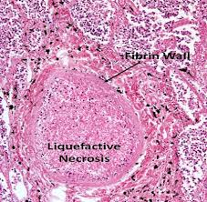
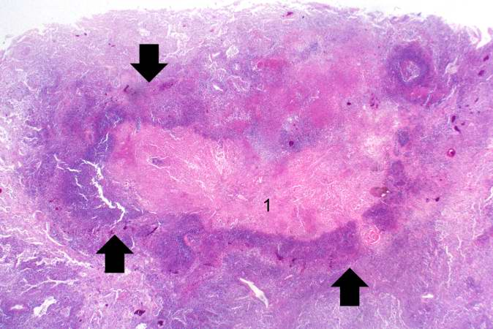
The Four Outcomes of Acute Inflammation
3-Abscess Formation (Suppuration):An abscess is a localized collection of pus in a tissue or organ, which is a specific pattern of acute inflammation. Typically caused by infection with pyogenic bacteria (pus-forming, e.g., Staphylococcus aureus), where extensive liquefactive necrosis occurs.

Slide 19
The Four Outcomes of Acute Inflammation
4-Progression to Chronic Inflammation: When the acute response fails to eliminate the injurious stimulus, the inflammation can persist and evolve into a prolonged process (weeks to years).

Slide 20


